Slide 1
Dynamic Movie
Recommendation System
Team 1
Yang Bai, 1063031
Xuejiao Dong, 1569734
Giang Vu, 1537937
Linxiu Jiang, 1051136

Slide 2
Use Cases (Business Use Cases)
User logins to system, and login service verifies user ID and password
If user is a new user, Recommendation System recommends top 10 popular movies
If use is an old user, Recommendation System recommends what this user likes
Real user rates movie by giving 0-5 star and gets recommendations in real-time
A new user becomes an old user by rating any movie
User types in other user ID, and gets intersection between what he/she likes and what others like
User views movie list by genres

Slide 3
Use Cases (System Use Cases)
Data Flow Service stimulates data flows
Data ETL Service collects all the rating records, and extract, transform, load these data
ML Service keeps training and building a new model based on the historical model and new dataset
ML model recommends 10 potential favorite movies to users
Virtualization Service virtualize data flows and accuracy of model

Slide 4
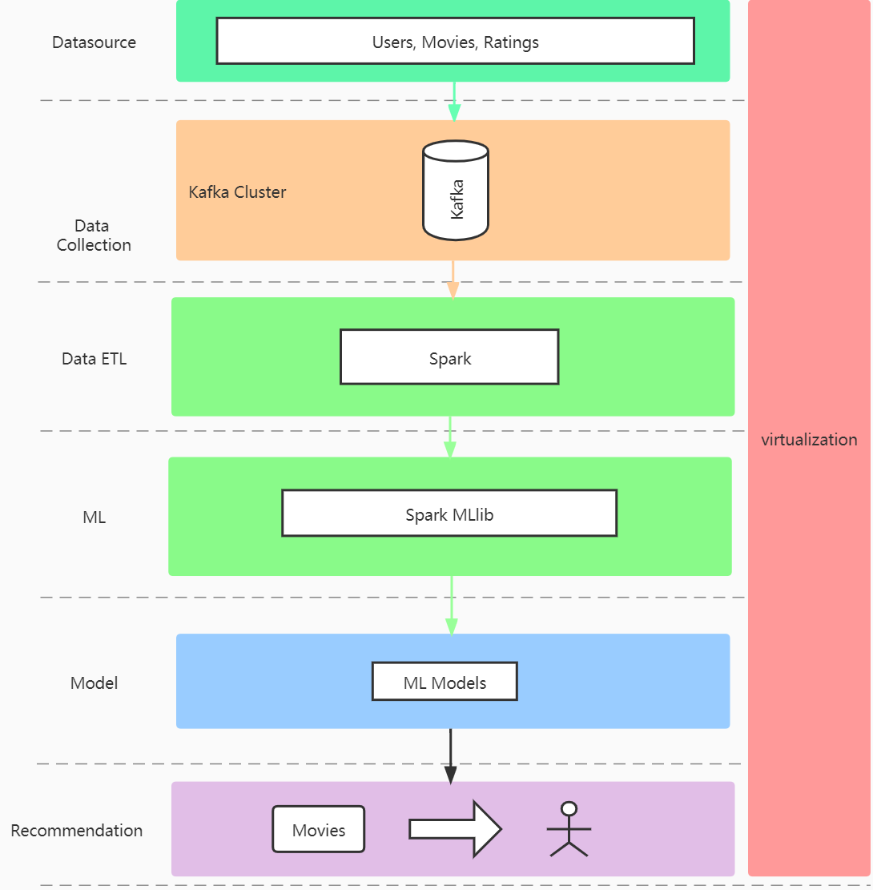
Architecture

Slide 5
Methodology
Step 1 Simulate Dynamic Data stream
Parallel Data Producer
We create multi-threads as producers to stimulate data flows
Stream Processing with Kafka
We use kafka to build a high-performance streaming platform that enables data pipelines, streaming analytics, and data integration.
Producer: push data of user actions into Kafka
Consumer: fetch data of user actions from Kafka and do streaming analytics by putting analytic results into Graphite

Slide 6
Methodology
Step 2 Dynamic Machine Learning
ETL and Data Preprocess
A new Consumer fetches user actions data and does preprocessing including decoding, feature extraction, and ends up with a dataset that can be used for dynamic ML training and modeling.
Model Generation
The Dataset describes a 5-star rating which can be used to build users' taste rules. Our recommender systems combine “content based filtering” and “collaborative filtering”. We dynamically train ML models based on historical models and new data streams of the dataset, and then come up with an optimal model.

Slide 7
Milestones/sprints
Week 9 (Nov. 1st - 7th) - Prepare Dev Environment, Learn New Techniques (All)
Week 10 (Nov. 8th - 14th) - Stimulate DataFlow (Linxiu)
Week 11 (Nov. 15th - 21st) - ETL DataSet (Xuejiao)
Week 12 (Nov. 22nd - 28th) - ML Train and Build Model (Yang)
Week 13 (Nov. 29th - Dec.5th) - Visualization + UI (Glenn)
Week 14 (Dec.6th - Dec.8th) - Final testing/Presentation (All)

Slide 8
Data Source
https://files.grouplens.org/datasets/movielens/ml-25m-README.html
This dataset describes 5-star rating. It contains 25,000,095 ratings and 1,093,360 tag applications across 62,423 movies. These data were created by 162,541 users between January 09, 1995 and November 21, 2019.
ratings.csv: userId,movieId,rating,timestamp
tags.csv: userId,movieId,tag,timestamp
movies.csv: movieId,title,genres
links.csv: movieId,imdbId,tmdbId
genome-scores.csv and genome-tags.csv: movieId,tagId,relevance

Slide 9
Technologies used + Repo for project
Technologies:
Kafka
Spark: Spark core, Spark Streaming, Spark MLlib
TSDB: Graphite
Play framework (High Velocity Web Framework)
Github:
https://github.com/youngbai/CSYE7200-MovieRecommendation

Slide 10
Acceptance Criteria
Stimulate DataFlow
stimulate real-time user rating requests, 1000 requests per seconds
ETL DataSet
present cleaned data samples in each steps by logging
ML Train and Build Model
expected accuracy threshold greater than 75%
Visualization
the amount of requests (users’ rating) by mins, hours (1s)
accuracy tendency chart (1s)
real user rates movie and gets recommendations less than 2 seconds

Slide 11
Goals of Project
learn how to implement a dynamic Big Data ecosystem
apply our Scala knowledge learned in class to Spark to solve a common, real-world problem
Improve the user experience by improving the accuracy of the recommendation system

Slide 12
Q & A

